Slide 1

Project – PROSPER
An ML Project on Students’ Drop-out Prediction

Slide 2






TEAM - ZENITH
3+ years IT sector
3+ years
IT sector
2+ years
IT sector
SHILPI KUMARI
Kiran Kumar
Sonicaa Kolluri
HARSHA VARDHAN
Adithya Guntupalli
Akarsh Gadikota
1+ year
IT sector
7+ years
Energy sector
4+ years
IT sector

Slide 3
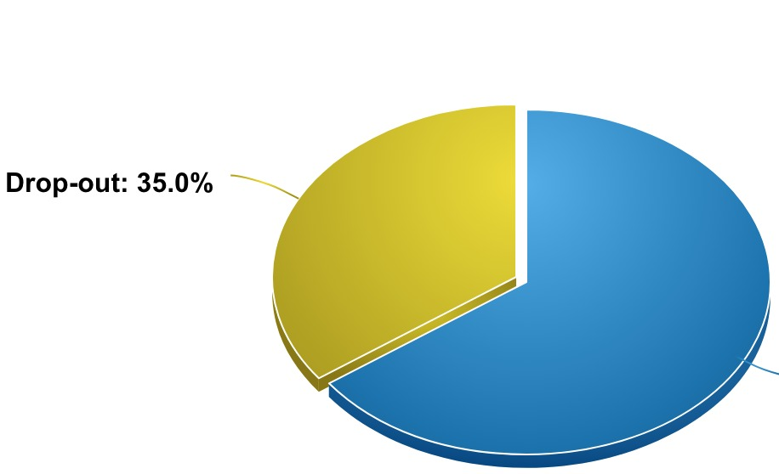
BUSINESS PROBLEM
(
Annual College Drop-outs in Portugal- 35% (Highest in OECD countries)
Revenue loss to the University
Affects the overall Country economy.

Slide 4
MACHINE LEARNING IN EDUCATION
Aulck, L., Velagapudi, N., Blumenstock, J., West, J.: Predicting student dropout in higher education. In: 2016 ICML Workshops #Data4Good Machine Learning, New York, vol. abs/1606.06364, pp. 16–20 (2016)
Serra, A., Perchinunno, P., Bilancia, M.: Predicting student dropouts in higher education using supervised classification algorithms. In: Gervasi, O., et al. (eds.) ICCSA 2018. LNCS, vol. 10962, pp. 18–33. Springer, Cham (2018). https://doi. org/10.1007/978-3-319-95168-3 2
V. Hegde and P. P. Prageeth, "Higher education student dropout prediction and analysis through educational data mining," 2018 2nd International Conference on Inventive Systems and Control (ICISC), 2018, pp. 694-699, doi: 10.1109/ICISC.2018.8398887.
Baneres, David, M. Elena Rodríguez-Gonzalez, and Montse Serra. "An early feedback prediction system for learners at-risk within a first-year higher education course." IEEE Transactions on Learning Technologies 12.2 (2019): 249-263.

Slide 5
DATASET
Source- UCI Machine Learning Repository
European Country-Portugal
Belongs to a Higher educational institution
4424 records of students’ personal details , academic performance of 1st year, macro-economic data(Total-37 attributes)
Target variable- Originally 3 class- Changed to binary class (Drop-out-Yes/No)

Slide 6

DATA CATEGORIES
Student Personal Details
University Academic Performance
Macro-economic factors

Slide 7

DATA PRE-PROCESSING
Target class converted to binary
Checked for Null Values, Blanks, Outliers
Ordinal Data to Categorical Data
Dropped Irrelevant columns
Balancing
Train-Test Split
70-30 ratio

Slide 8
FINAL PREDICTORS
Student personal details captured at the time of enrolment
Student academic performance in the first and second semesters

Slide 9

MACHINE LEARNING MODELS
Decision Tree
Random Forest
AdaBoost
Gradient Boost
XGBoost
K-Nearest Neighbours
Logistic Regression
Artificial Neural Networks

Slide 10
PERFORMANCE METRICS
Accuracy- Ratio of correct Predictions(both Drop-out and Not Drop-out) over the total number of instances
Sensitivity/Recall- Ratio of True Positives to the total number of instances that have an actual positive class.

Slide 11
MODELS PERFORMANCE

Slide 12
CONCLUSIONS
Model performs well for this dataset and specific courses. University can leverage this with the available information.
More Data required for scaling the model to other universities/countries.
Higher Education- Personal Growth, University revenue-Countries economy
ANN is the Best model in terms of Recall and Accuracy

